Slide 1
Object Oriented Programming

Slide 2
Today Topic
Polymorphism

Slide 3
Polymorphism
Polymorphism is a Greek word consisting of two words poly means many, and morphism means shapes.
In simple words, we can define polymorphism as the ability of a message to be displayed in more than one form.

Slide 4
Polymorphism Example
Real life example of polymorphism, a person simultaneously can have different characteristics.
A person at the same time is a father, a husband, and an employee. So, the same person can have different behaviour in different situations.
Mobile is one device but offers various features such as a camera, radio, etc. This is called polymorphism.

Slide 5
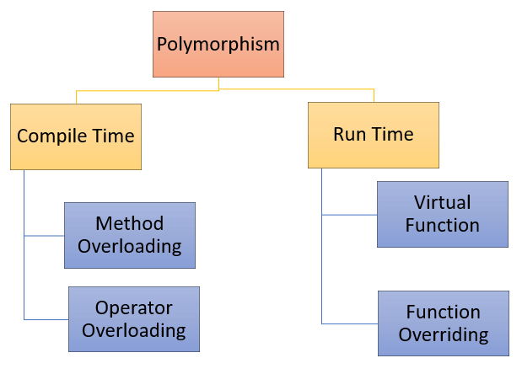
Polymorphism Types

Slide 6
Polymorphism Types
Polymorphism in C++ is categorized into two types.
Compile Time Polymorphism
Function overloading
Operator overloading
Run Time Polymorphism
Function Overriding
Virtual Function

Slide 7
1. Compile Time Polymorphism
When the relationship between the definition of different functions and their function calls is determined during the compile-time, it is known as compile-time polymorphism.
This type of polymorphism is also known as static or early binding polymorphism. All the methods of compile-time polymorphism get called or invoked during the compile time

Slide 8
1. Compile Time Polymorphism
It indicates that all information required to call a function is known at the compile time.
It means the compiler decides at compile-time what method will respond to the message sent to the pointer.

Slide 9
Implementation of Compile Time Polymorphism
You can implement compile-time polymorphism using function overloading and operator overloading.

Slide 10
a. Function overloading
Function overloading means one function can perform many tasks.
In C++, a single function is used to perform many tasks with the same name and different types of arguments.
In the function overloading function will call at the time of program compilation. It is an example of compile-time polymorphism.

Slide 11
a. Function overloading (Source.cpp)
#include<iostream>
#include "Header.h"
using namespace std;
int main()
{
functionOverloadExample obj;
obj.function(10);
obj.function(20.20f);
obj.function(30.303);
obj.function("Umer Arshad Butt");
return 0;
}

Slide 12
a. Function overloading (Header.h)
void function(const char* D)
{
int length = 0;
for (int i = 0; D[i] != '\0'; i++)
{
++length;
}
d = new char[length];
for (int i = 0; i < length; i++)
{
d[i] = D[i];
}
d[length] = '\0';
cout << " Char Name is: " << d << endl;
}
};
#pragma once
#include <iostream>
using namespace std;
class functionOverloadExample {
private:
int a;
float b;
double c;
char* d;
public:
void function(int A)
{
a = A;
cout << " Integer value: " << a << endl;
}
void function(float A)
{
b = A;
cout << " Float value: " << b << endl;
}
void function(double A)
{
c = A;
cout << " Double value: " << c << endl;
}

Slide 13
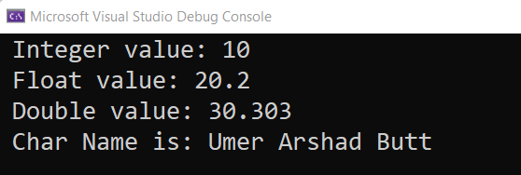
Output

Slide 14
b. Operator overloading
Operator overloading is an essential concept in C++. You can redefine or overload most of the built-in operators available in C++.
Operator overloading is sometimes referred to as ad-hoc polymorphism too. In operator overloading, different operators display different implementations based on their parameters or signatures.

Slide 15
b. Operator overloading (Source.cpp)
#include<iostream>
#include "Header.h"
using namespace std;
int main()
{
operatorOverloading obj, obj2, obj3;
obj.setValues(10, 20);
obj2.setValues(20, 80);
obj3 = obj + obj2;
obj3.display();
return 0;
}

Slide 16
a. Function overloading (Header.h)
#pragma once
#include <iostream>
using namespace std;
class operatorOverloading {
private:
int a, b;
public:
void setValues(int A, int B)
{
a = A;
b = B;
}
operatorOverloading operator+(operatorOverloading access)
{
operatorOverloading d;
d.a = a + access.a;
d.b = b + access.b;
return d;
}
void display()
{
cout << " Sum of a + a is: " << a << endl;
cout << " Sum of b + b is: " << b << endl;
}
};

Slide 17
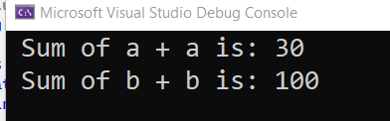
Output

Slide 18
2. Run Time Polymorphism
Runtime polymorphism is also known as dynamic polymorphism or late binding.
In runtime polymorphism, the function call is resolved at run time.
Run time is the period when the executable code is running.
Errors that occur during the execution of a program are called run-time errors. Run time errors aren’t detected by the compiler.

Slide 19
2. Implementation of Run Time Polymorphism
Runtime polymorphism is achieved using a combination of function overriding and virtual functions.

Slide 20
a. Function overriding
In C++ inheritance, we can have the same function in the base and derived classes.
When we call the function using an object of the derived class, the function of the derived class is executed instead of the one in the base class.
So, different functions are executed depending on the object calling the function.

Slide 21
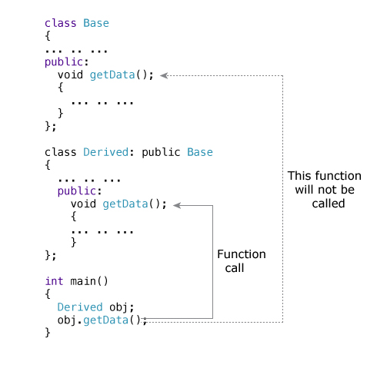
a. Function overriding

Slide 22
a. Function overriding (source.cpp)
#include<iostream>
#include "Header.h"
using namespace std;
int main()
{
derivedClass obj;
obj.display();
return 0;
}

Slide 23
a. Function overriding (Header.h)
#pragma once
#include <iostream>
using namespace std;
class baseClass {
public:
void display()
{
cout << " Base Class Execute " << endl;
}
};
class derivedClass: public baseClass {
public:
void display()
{
cout << " Derived Class Execute and this derive class override the function of base class " << endl;
}
};

Slide 24
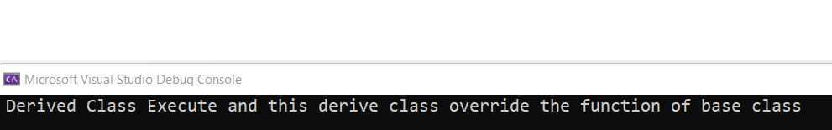
output

Slide 25
How Polymorphism is achieved in c++
In C++, polymorphism, the member functions with the same prototype (signature) are defined in each derived class as in the base class.

Slide 26
How Polymorphism is achieved in c++
Polymorphism is achieved by means of virtual functions.
It is done by the fact that one pointer to a base class object (one base class pointer) may also point to any object of its derived class.

Slide 27
Virtual Functions
A virtual function is a member function that is declared within a base class and redefined by a derived class.
The whole function body can be replaced with a new set of implementations in the derived class.

Slide 28
How to write Virtual Functions
To make a function virtual, the virtual keyword must precede the function declaration in the base class.
The redefinition of the function in any derived class does not require a second use of the virtual keyword.

Slide 29
Diff b/w virtual and non-virtual member Functions
The difference between a non-virtual member function and a virtual member function is, the non-virtual member functions are resolved at compile time.
Whereas the virtual member functions are resolved at run-time.
The concept of pointers to objects is prior to knowing before implementing the virtual function.

Slide 30
Pointer to Object / Object Pointer
A pointer can point to a class object. This is called an object pointer.
Object pointers are useful in creating objects at run time and public members of the class can be accessible by object pointers.
For example, we can create pointers pointing to classes, as follows:
Shape *optr; i.e., the class name followed by an asterisk (*) and then the variable name. Thus, in the above declaration, *optr is a pointer to an object of class Shape.
To refer directly to a member of an object pointed by a pointer we can use the arrow operator (- >) instead of dot ( . )

Slide 31
Function overriding with virtual function (source.cpp)
#include<iostream>
#include "Header.h"
using namespace std;
int main()
{
shape* ptr_to_object;
shape* ptr_to_object1;
shape* ptr_to_object2;
triangle tri_object;
ptr_to_object = &tri_object;
square sqr_object;
ptr_to_object1 = &sqr_object;
circle crc_object;
ptr_to_object2 = &crc_object;
ptr_to_object->set_value(10, 20);
cout << ptr_to_object->area() << endl;
ptr_to_object1->set_value(10, 20);
cout<< ptr_to_object1->area() << endl;
ptr_to_object2->set_rad(10);
cout<< ptr_to_object2->area();
return 0;
}

Slide 32
Function overriding with virtual function (Header.h)
#pragma once
#include <iostream>
using namespace std;
class shape {
protected:
int len, wid, rad;
public:
void set_value(int l, int w)
{
len = l;
wid = w;
}
void set_rad(int r)
{
rad = r;
}
virtual int area()
{
return 0;
}
};
class triangle :public shape {
public:
int area()
{
cout << " Area of Triangle: ";
return 0.5 * (len * wid);
}
};
class square :public shape {
public:
int area()
{
cout << " Area of Square: ";
return len * wid;
}
};
class circle :public shape {
public:
int area()
{
cout << " Area of circle: ";
return 3.14 * rad * rad;
}
};

Slide 33
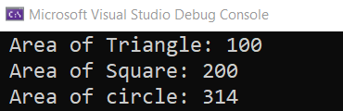
Output

Slide 34
Function overriding with virtual function (source.cpp)
#include<iostream>
#include "Header.h"
using namespace std;
int main()
{
shape *obj1;
shape* obj2;
shape* obj3;
triangle tri_obj(10,20,30);
square sqr_obj(10, 20, 30);
circle crl_obj(10, 20, 30);
obj1 = &tri_obj;
obj2 = &sqr_obj;
obj3 = &crl_obj;
cout << obj1->area() << endl;
cout << obj2->area() << endl;
cout << obj3->area() << endl;
return 0;
}

Slide 35
Function overriding with virtual function (Header.h)
#pragma once
#include <iostream>
using namespace std;
class shape {
protected:
int len, wid, radius;
public:
virtual int area()
{
return 0;
}
};
class triangle:public shape {
public:
triangle(int l, int w, int r)
{
len = l;
wid = w;
radius = r;
}
int area()
{
cout << " Triangle of Area: ";
return 0.5 * len * wid;
}
};
class square :public shape {
public:
square(int l, int w, int r)
{
len = l;
wid = w;
radius = r;
}
int area()
{
cout << " Square of Area: ";
return len * wid;
}
};

Slide 36
Function overriding with virtual function (Header.h)
class circle :public shape {
public:
circle(int l, int w, int r)
{
len = l;
wid = w;
radius = r;
}
int area()
{
cout << " Circle of Area: ";
return 3.14 * radius * radius ;
}
};

Slide 37
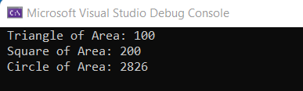
Output

